Slide 1
ASSIGNMENT Name: Ambuj Singh
Problem Statement
Based on the data of both the Chinese and the Indian markets, task is to help the company decide whether to enter the Indian market. Since you can’t analyze the entire Indian and the Chinese market, the company has asked you to analyze sample data over two major cities, one from each country, to understand the sales pattern. Therefore, you are provided with the data for Shanghai and Mumbai.
Assignment Objective
Identify Potential Market
Potential Customer Base In India
Business Decision and Estimated Sales and Revenue

Slide 2
PART I: Potential Customer Base in India Identify Potential Market / Classification Model

Slide 3
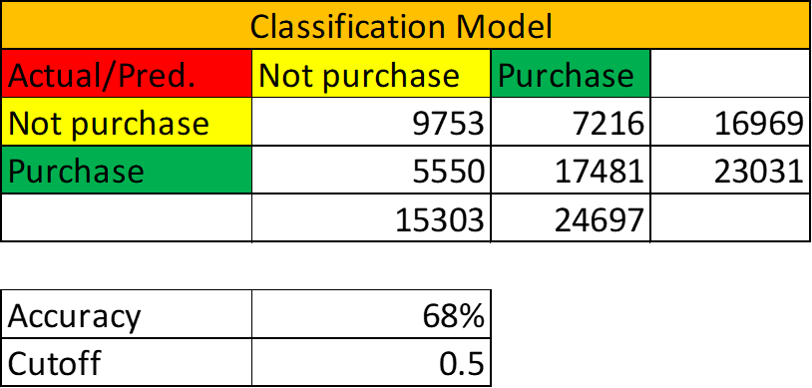
PART I : Potential Customer Base in India Identify Potential Market
According to the classification model we can see that accuracy of this model is up to 68 % with a cut-off value of 0.5.
We have segmented data on behalf of the phone age category in 4 Segments as described in the figure.
Gender-wise distribution, in that 55.71% of all population belongs to Male Category.
Age Wise Distribution, most of the person belongs to the (25-39),(40-54) Age Group and majority in male persons those who have purchased a new phone.
We have further analyzed the Classification model for Accurate Results. By Accuracy, Sensitivity of model, and Specificity of model

Slide 4
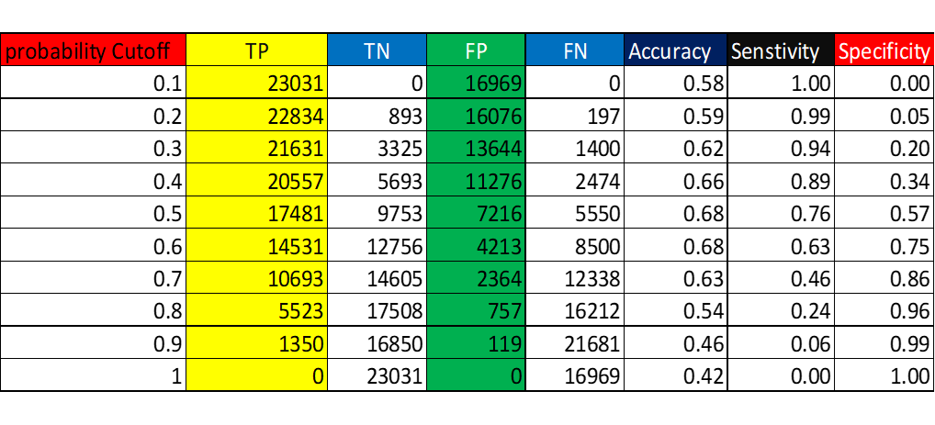
PART I : Potential Customer Base in India Identify Potential Market
According to Salary wise distribution we can see that those who belong to the medium income category have a maximum purchase ratio of up to 25.07%
Those who have higher income have purchased fewer smartphones according to EDA.
On further investigation of the Classification model we have analyzed the sensitivity of the model for different y and of 0.6% model is having maximum Accuracy, Sensitivity, and Specificity.
So on Cut-off 0.6% Accuracy, Sensitivity, Specificity are as follows-0.68%,0.76%,0.57%
Confusion Matrix for different Probability Cut-off is given in table.

Slide 5
PART II : Customer Segmentation Clusters for Effective Marketing
We have used K Means Clustering to optimize the solution for the different categories.
We found three Different clusters having different properties.
Purchase probability for these clusters more than Cut-off value 0.5%

Slide 6
PART II : Customer Segmentation Clusters for Effective Marketing
We can see that from Iteration for Optimization of clusters we will get three clusters for different category
• Cluster 1 belongs to Youth Category and has an income more than Senior. Category People and Phone Purchasing probability 0.56% cut off is 0.50% then they buy New. Phone
• Cluster 2 This Cluster Belongs to Old Category and has Least Income. Category People and Phone Purchasing probability 0.51% cut off is 0.50% then they buy New. Phone
• Cluster 3 This Cluster Belongs to Senior Category and has Superior Income. Category People and Phone Purchasing probability 0.66% cut off is 0.50% then they buy New. Phone

Slide 7
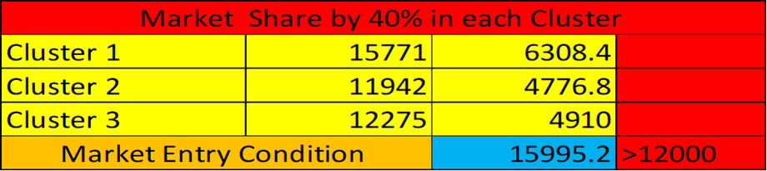
PART III: Business Decision Expected Sales and Revenue
From Indian Market data Set we have interpreted some data points that are as follows.
For the Indian data set most of the persons to use phones up to four years so as per the analysis we have performed on the Chinese Data Set, it is predicted that they have exceeded the limit to using the phone so they are willing to buy a new phone.
As per the Indian Data Set Annual Income of People belonging to Different Categories having high ratio than in the Chinese data set.
As per the Analysis Market Entry Condition is fulfilled for the given data set.
Sum of 40 % Shares of All Clusters (15995>12000) [Market Entry Condition for Indian Market] [Total Unit Sold >12000]

Slide 8
PART III: Business Decision Expected Sales and Revenue
The expected revenue that the company can generate under each cluster
Cluster 1- [119859600] Rs Approx.
Cluster 2- [90759200] Rs Approx.
Cluster 3- [93290000] Rs Approx.
Market Entry Condition for Company Establishment is Sales Should be Grater than 12000 units.
Total Revenue generated for withstanding in the market is also fulfilling the condition.
2. The final decision is that company should enter the Indian market with business justification as per the Classification Model

